Slide 1

TEAM E
PROJECT
ELEVATOR CONTROL

Slide 2



INTRODUCTION
AGENDA
PART 2
Development &
Quality Control
PART 1
Introduction &
Overview
PART 3
Implementation &
Demo

Slide 3
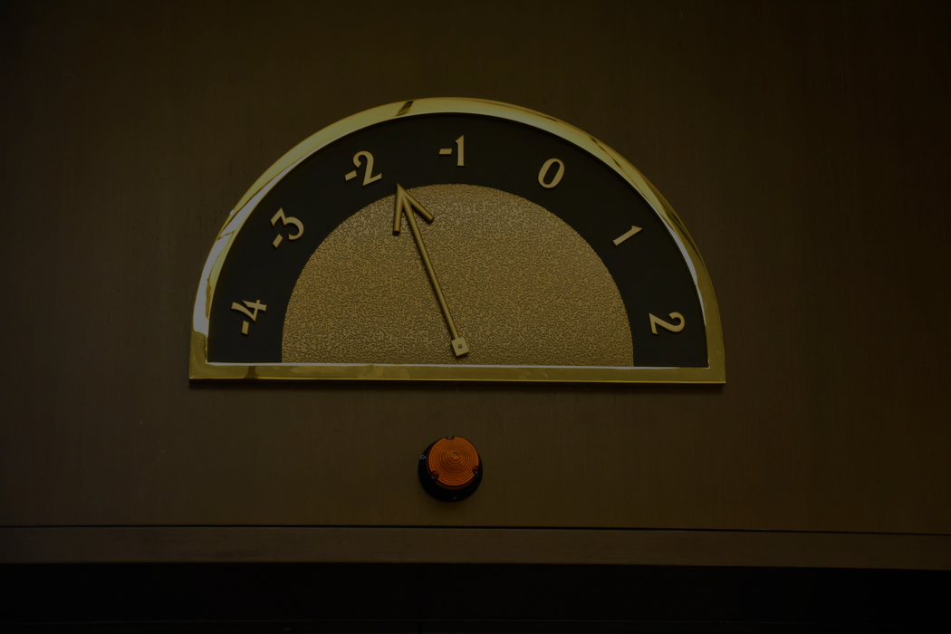
1
INTRODUCTION &
OVERVIEW

Slide 4

ABOUT US
TEAM E
Harald Pinsker
Paul Schmutz
Roman Socovka

Slide 5
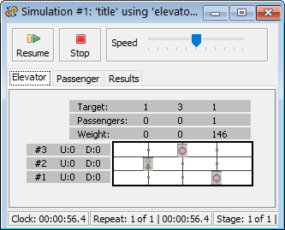
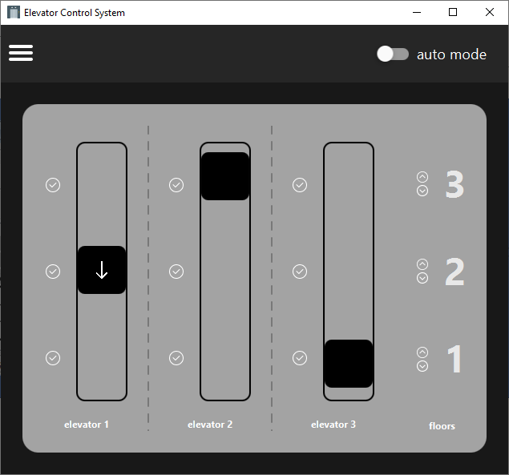
PROJECT
OVERVIEW
<simulator screenshot>
<elevator app screenshot>
SIMULATOR
RMI
ELEVATOR CONTROL

Slide 6





PROGRAMMING & TESTING
TECH STACK
KOTLIN
Programming Language
GOOGLE GUICE
Dependency Injection
MOCKITO
Mocking
JUNIT
Unit Testing
JACOCO
Code Coverage

Slide 7





SOFTWARE
TOOLS
FIGMA
UI Mockups
INTELLIJ
IDE
GITHUB
Version Control
GITHUB ACTIONS
CI
SONARCLOUD
Code Quality

Slide 8
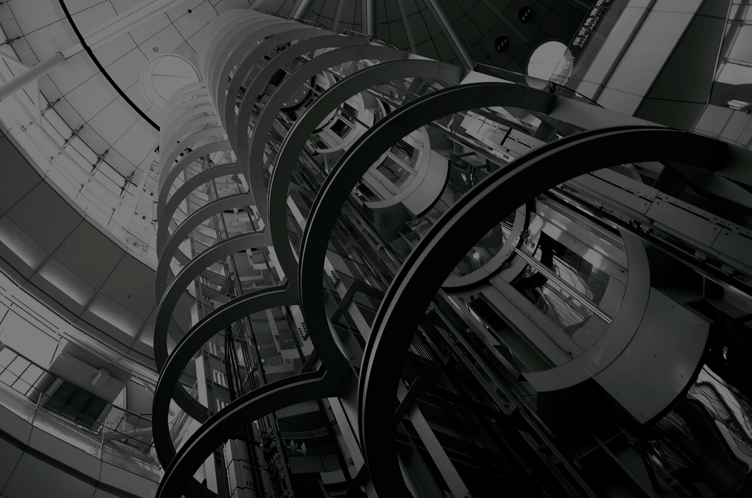
2
DEVELOPMENT &
QUALITY CONTROL

Slide 9
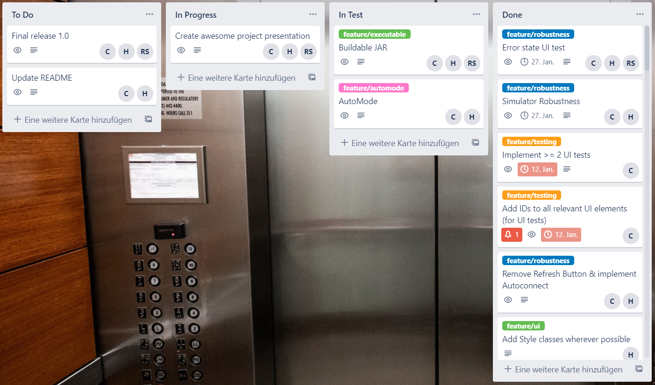
TRELLO
MANAGEMENT & COORDINATION

Slide 10
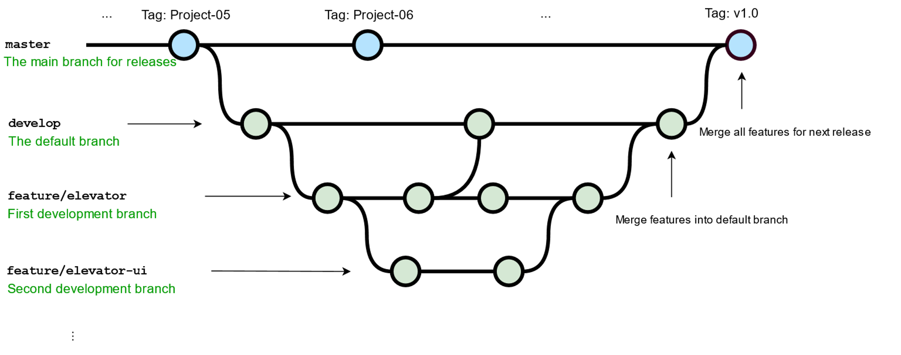
GIT
BRANCHING

Slide 11
GITHUB PULL REQUESTS
PEER CODE REVIEWS
1
accept
2
3
CREATE PULL REQUEST
REVIEW BY PEERS
MERGE
reject

Slide 12



GITHUB ACTIONS
BUILD AUTOMATION & CI
1
2
TRIGGER
GitHub Actions Build
master, develop, PR
Unit tests,
jacoco,
SonarCloud
adapt code

Slide 13
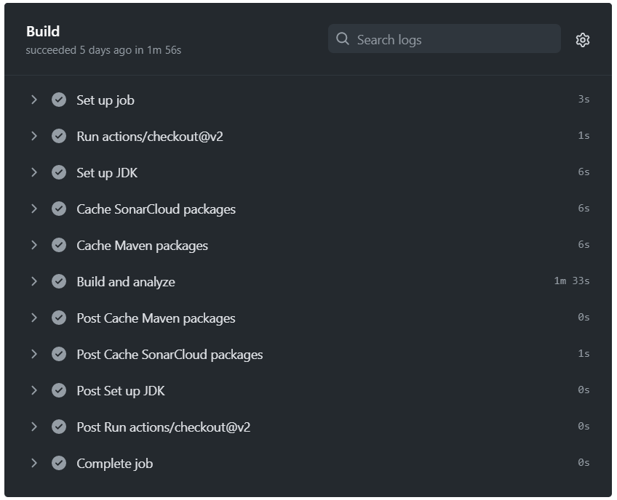
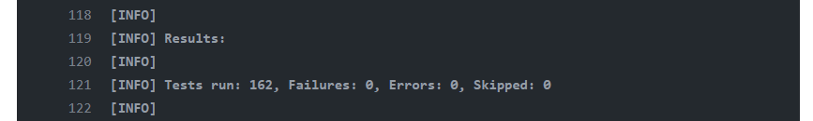
GITHUB ACTIONS
AUTOMATED TEST EXECUTION
Tests are run in the "Build and analyze" - stage

Slide 14
TESTING
TestFX
MOCKING
UI TESTING

Slide 15
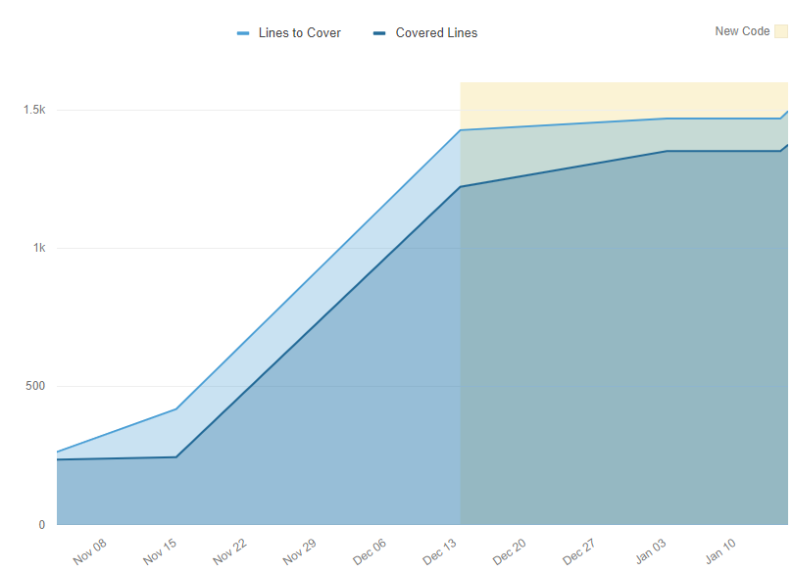
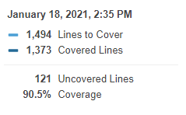
Add coverage screenshot here from sonarcloud
Or rewrite it in a diagram
Show different coverage metrics (line, branch, …)
JACOCO & SONARCLOUD
CODE COVERAGE

Slide 16
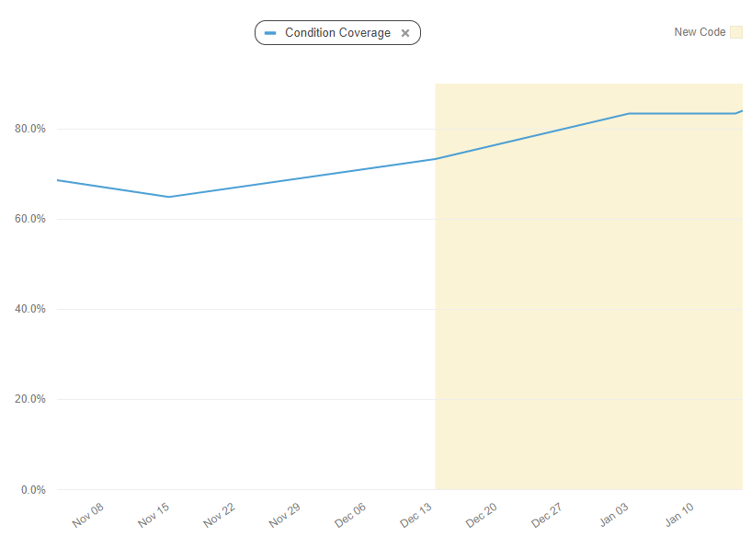
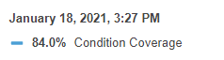
Add coverage screenshot here from sonarcloud
Or rewrite it in a diagram
Show different coverage metrics (line, branch, …)
JACOCO & SONARCLOUD
CODE COVERAGE

Slide 17
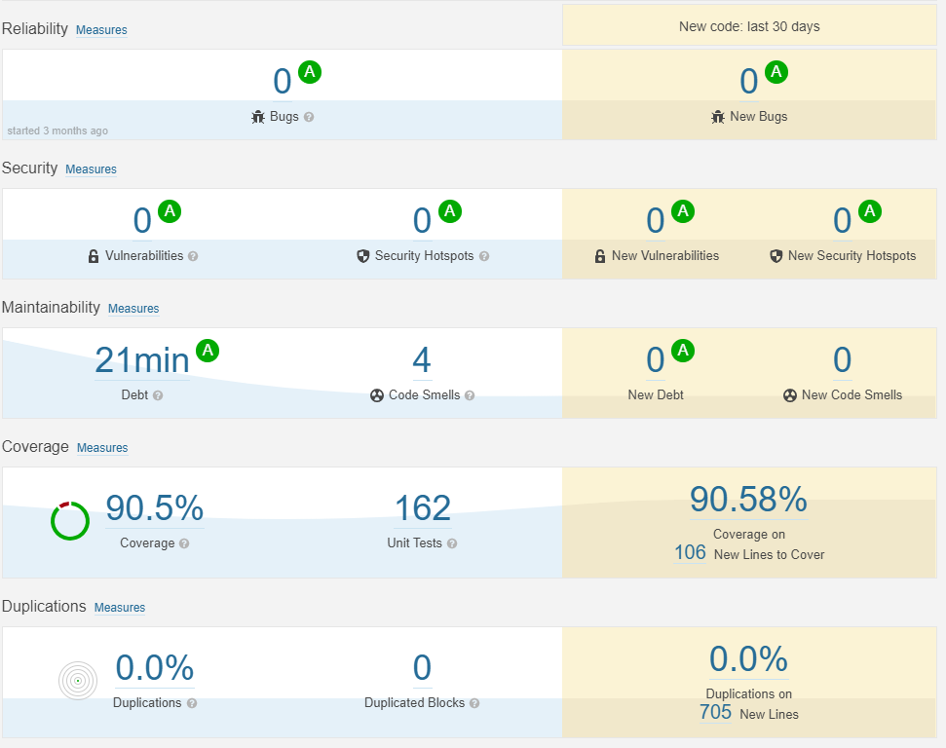
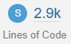
SONARCLOUD
STATIC ANALYSIS

Slide 18
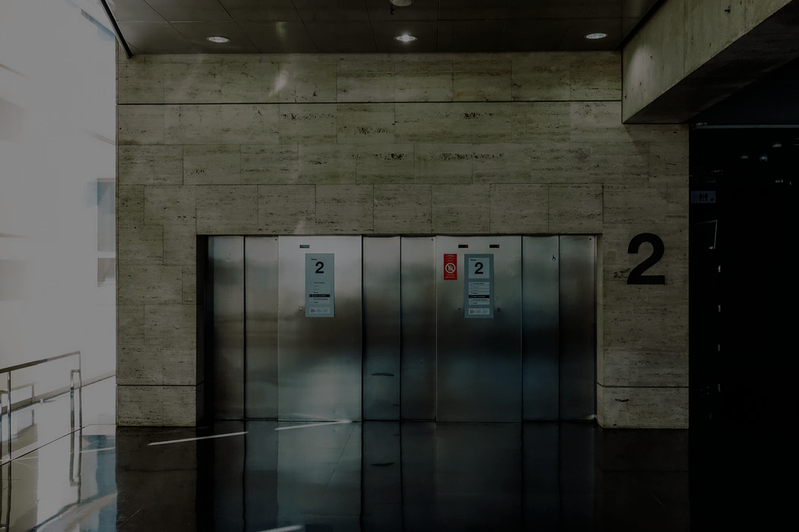
3
IMPLEMENTATION &
DEMO

Slide 19
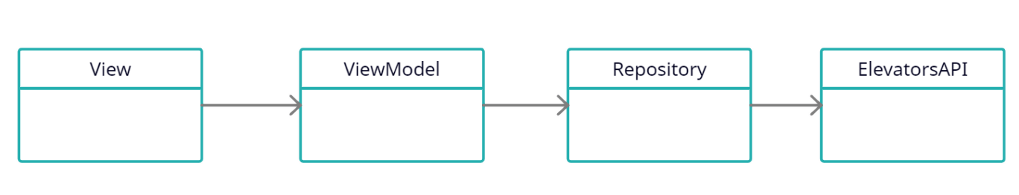
ARCHITECTURE OVERVIEW
ARCHITECTURE
Splitted into GUI, business logic and API components
Detailed version on https://app.creately.com/diagram/Nprp7n9HQEJ

Slide 20




ARCHITECTURE OVERVIEW
GRAPHICAL UI
JavaFX used for graphical user interfaces
main.css
Strings_de.properties
Strings_en.properties
localization
View.fxml
View.kt
ViewModel.kt
property
bindings

Slide 21

ELEVATOR CONTROL SYSTEM
LIVE DEMO

Slide 22

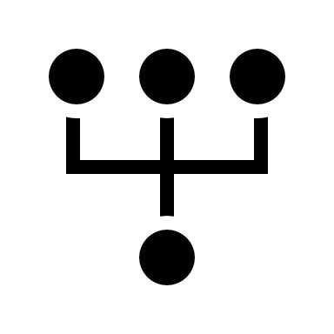

CHALLENGES & LESSONS LEARNED
QUALITY GATES & CODE REVIEWS
Help to keep quality at a high level, even with many people working on a project over a long time – over 2.9k fancy lines of code developed!
ARCHITECTURE DIAGRAMS
To keep an overview of the project
TRICKY PARTS
Develop good-looking views with JavaFX
Generating runnable JAR

Slide 23
TEAM E
PROJECT
ELEVATOR CONTROL

